Slide 1

EXPLORATORY DATA ANALYSIS ON AMEO DATASET

Slide 2
DESCRIPTION:
About Dataset
The dataset was released by Aspiring Minds from the Aspiring Mind Employment Outcome 2015 (AMEO). The study is primarily limited only to students with engineering disciplines. The dataset contains the employment outcomes of engineering graduates as dependent variables (Salary, Job Titles, and Job Locations) along with the standardized scores from three different areas – cognitive skills, technical skills and personality skills. The dataset also contains demographic features. The dataset contains around 40 independent variables and 4000 data points. The independent variables are both continuous and categorical in nature. The dataset contains a unique identifier for each candidate.

Slide 3
OBJECTIVE:
The primary objective of conducting Exploratory Data Analysis (EDA) on the Aspiring Mind Employment Outcome 2015 (AMEO) dataset is to gain comprehensive insights into the employment outcomes of engineering graduates. The analysis aims to explore patterns, relationships, and trends within the dataset, shedding light on the various factors influencing salary, job titles, job locations, and the performance of candidates in the AMCAT exam(Aspiring Minds Computer Adaptive Test).

Slide 4
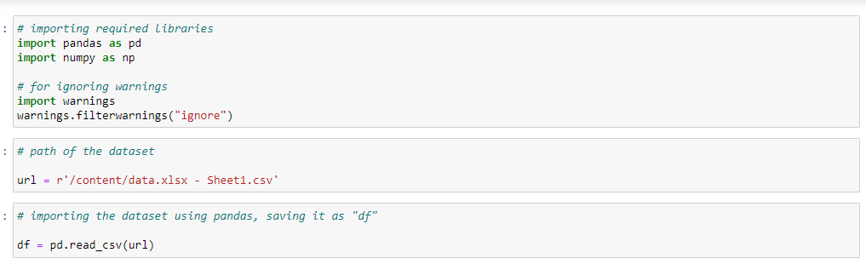
STEP-1:
The code reads a CSV file named 'data.xlsx - Sheet1.csv' into a Pandas DataFrame, suppressing warnings during the process. The DataFrame is stored in the variable 'df'.

Slide 5
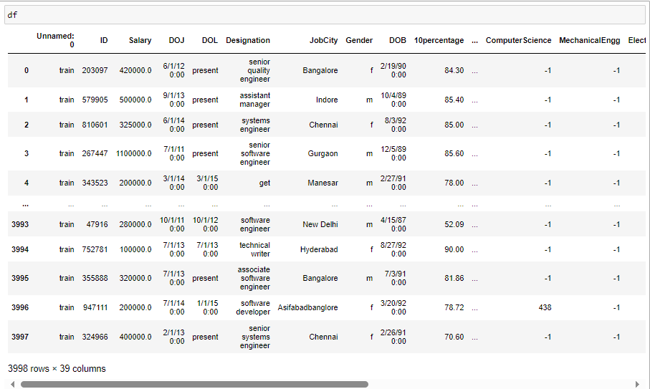

Slide 6
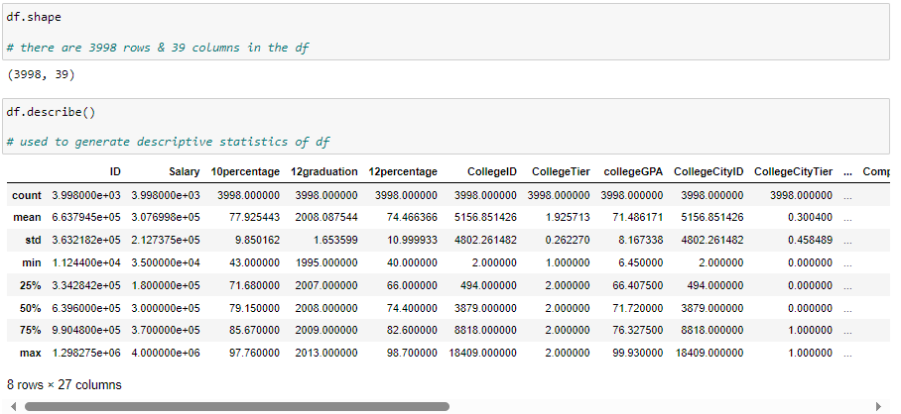
The code examines the DataFrame 'df' by reporting its dimensions using 'df.shape', presenting summary statistics for numerical columns with 'df.describe()', and displaying information on data types and memory usage using 'df.info()'.

Slide 7
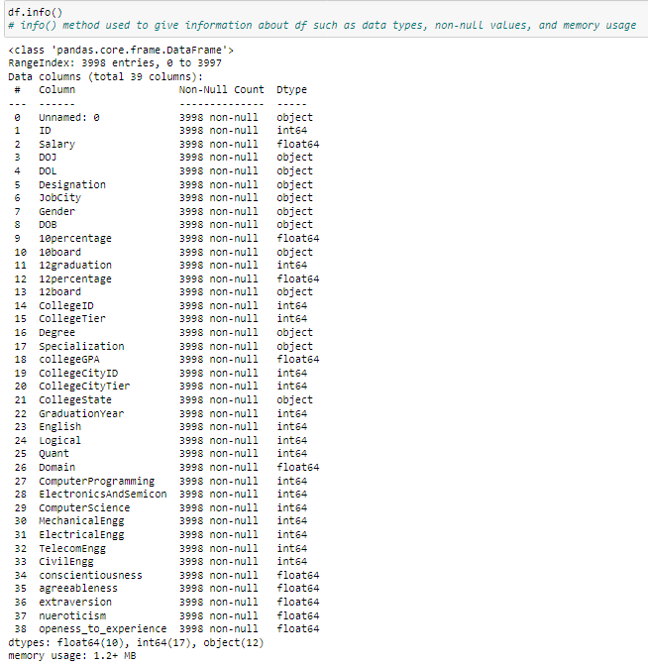

Slide 8

STEP-2:
Data Cleaning/Data Preprocessing
Data cleaning, also known as data preprocessing, involves identifying and correcting errors or inconsistencies in raw datasets to enhance their quality and reliability. This process includes handling missing values, removing duplicates, standardizing formats, and transforming variables to prepare the data for accurate analysis and modeling.

Slide 9
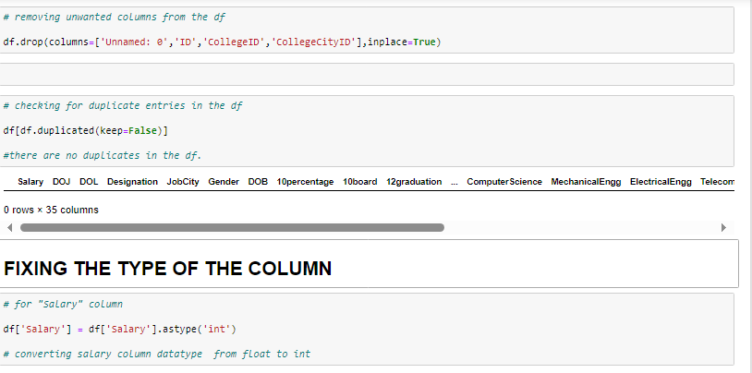
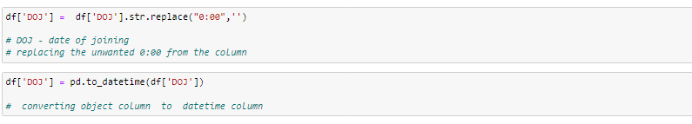

Slide 10
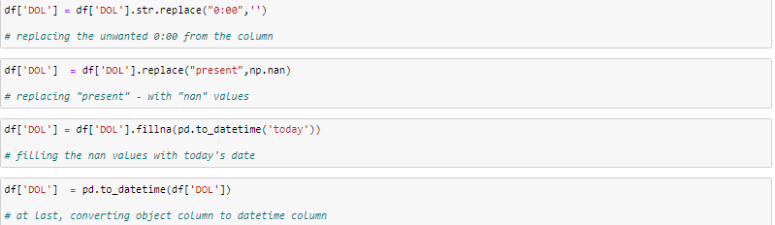
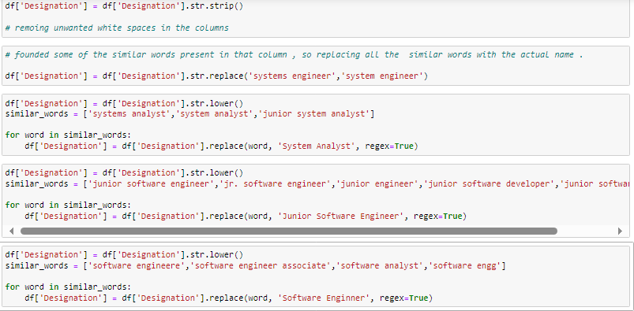

Slide 11
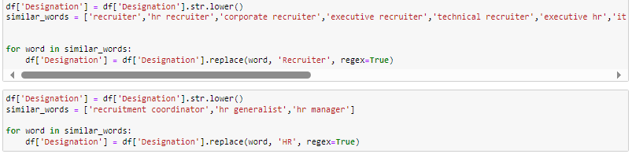
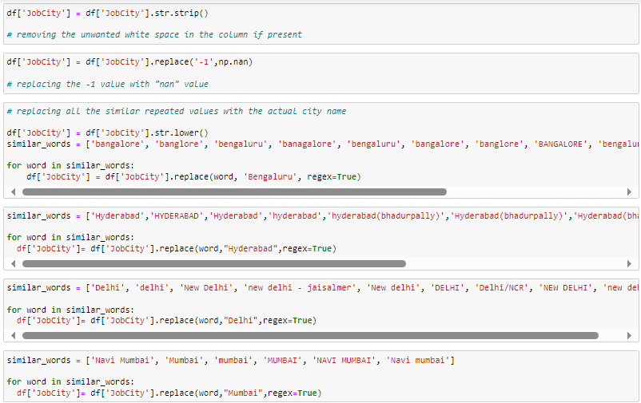

Slide 12
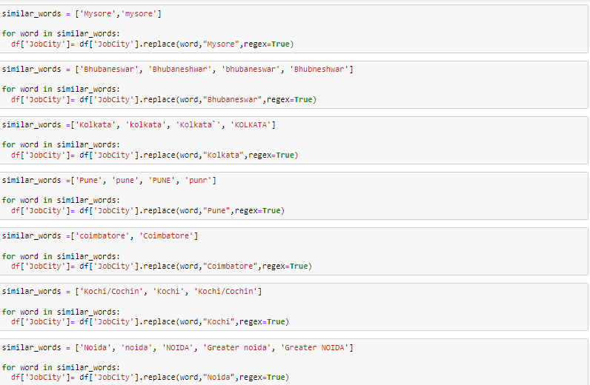
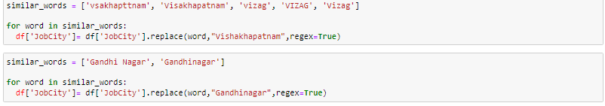

Slide 13
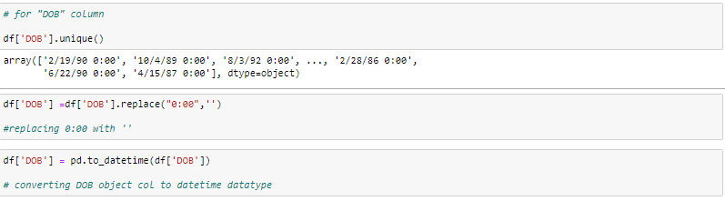



Slide 14
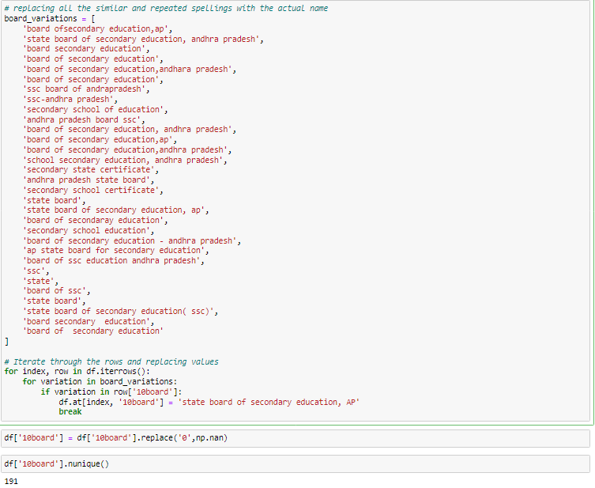

Slide 15
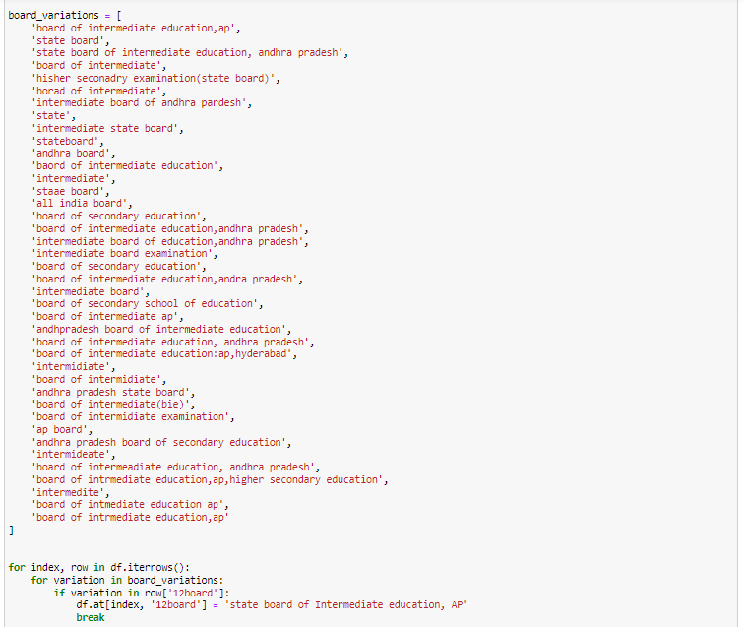

Slide 16
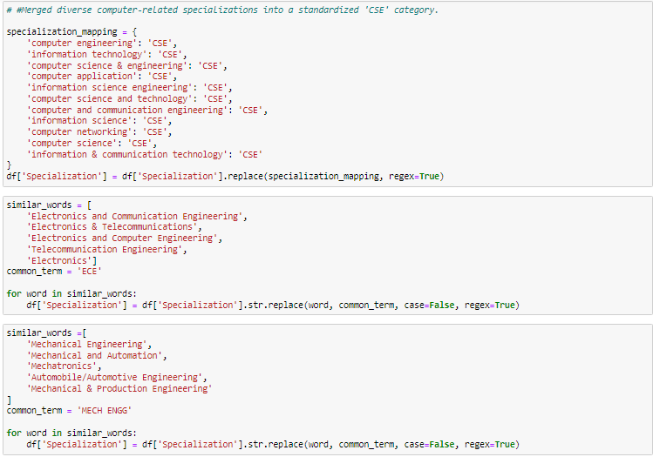

Slide 17
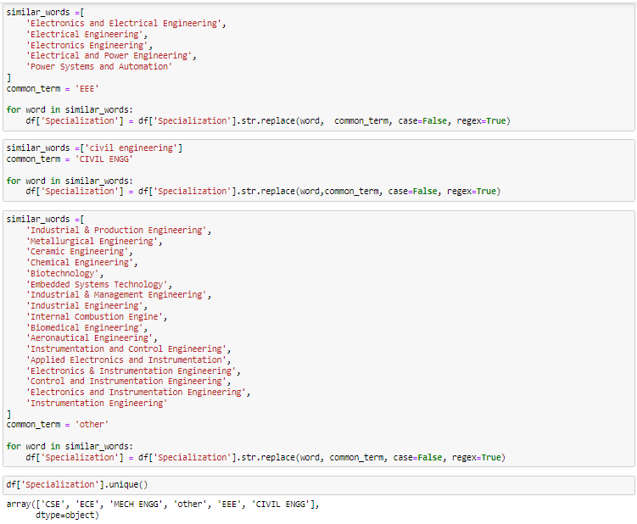

Slide 18
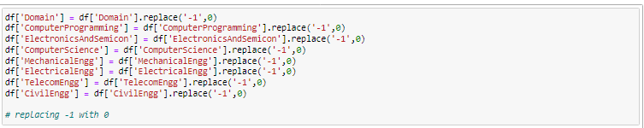
HANDLING OUTLIERS:
Outliers are extreme values that deviate significantly from the majority of data points. Handling outliers is crucial to prevent their undue influence on statistical analyses, ensuring more accurate and robust model predictions.

Slide 19
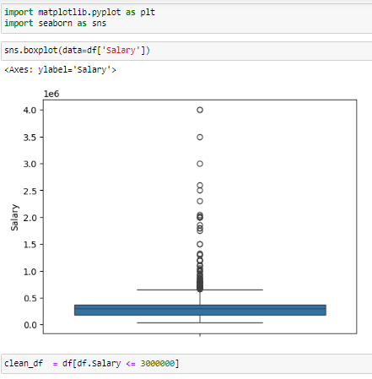
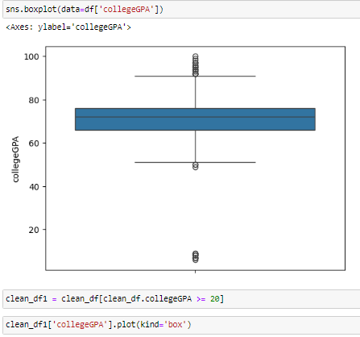
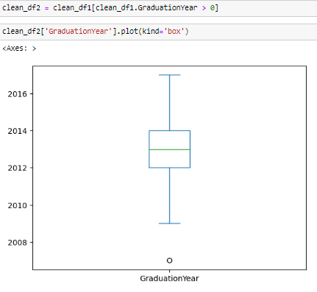

Slide 20
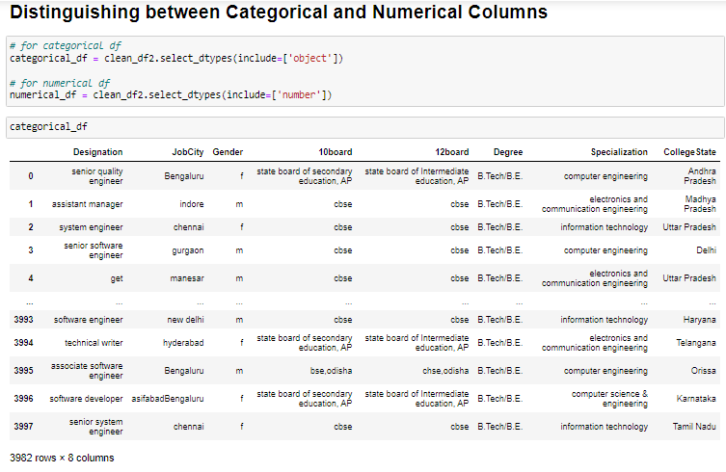

Slide 21
Univariate analysis:
Univariate analysis involves the examination and interpretation of a single variable in isolation from other variables. It aims to understand the distribution, central tendency, and variability of the individual variable. Common methods of univariate analysis include measures such as mean, median, mode, range, and standard deviation for numerical data, and frequency distributions, histograms, and bar charts for categorical data. Univariate analysis provides a foundational understanding of individual variables before exploring relationships with other variables in multivariate analysis.
In univariate analysis, statistical measures and graphical representations are utilized to summarize and analyze the characteristics of a single variable. This examination aids in uncovering patterns, trends, and outliers within the variable, laying the groundwork for more complex analyses.

Slide 22
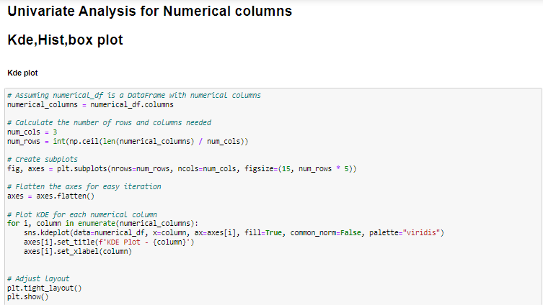
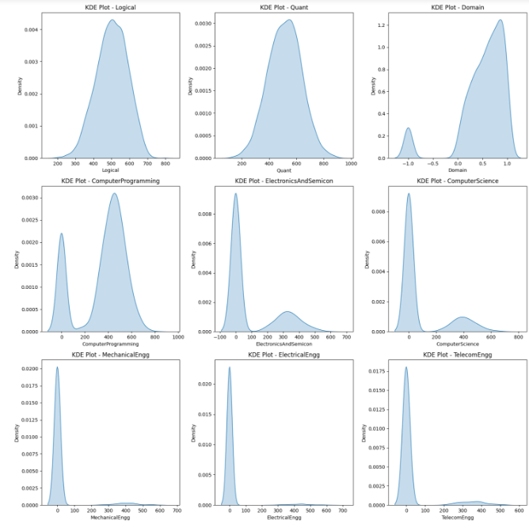
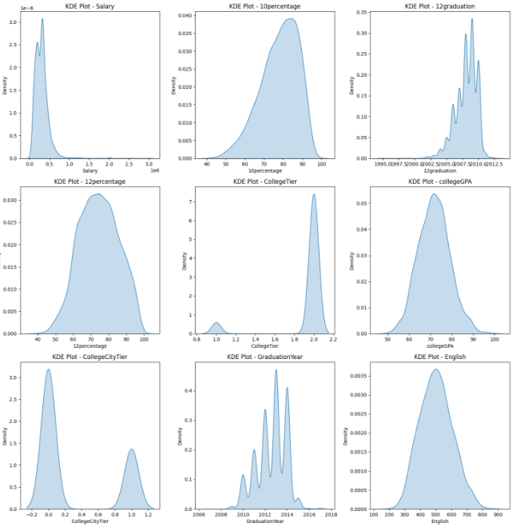

Slide 23
Plotted Kde-plots for all numerical columns present in the dataset The kdeplot in Seaborn is used to plot univariate or bivariate kernel density estimates. Kernel density estimation (KDE) is a non-parametric way to estimate the probability density function of a random variable. It provides a smooth curve that represents an estimate of the probability distribution of the data. Observations:
-> There is peak at 300000, that means most of the candidates are earning 300000
-> there is a slightly left skew in 10percentage column, that means some of the candidates 10percentage is less.
-> But most of candidates 10percentage marks are high ,between 70 - 100%
-> Most of the candidates completed there 12graduation in the year 2007 to 2012,peak pts are at 2007 & 2012
-> 12percentage marks also scored very well by all candidates, they scored in between 60-90% which is a good score.
-> Most of the candidates are belonged to tier-2 college.
-> The GPA scored by candidates when are studied in college is also seem good plot, GPA is betwen 60-90
-> Most of the candidates completed their graduation in the year of 2013.
-> The scores of candidates in AMCAT exam in English section are in between 200-800 but most of the candidates scored 500 marks.
-> The same scoring is also seems in logical & Quant sections in AMCAT exam.

Slide 24
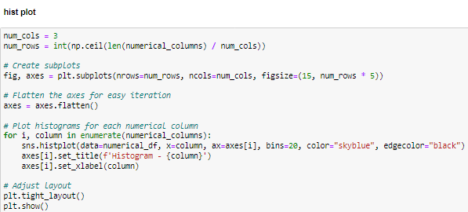
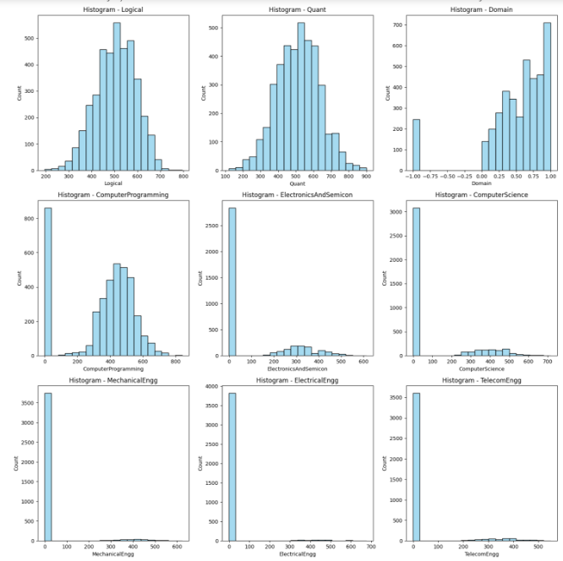
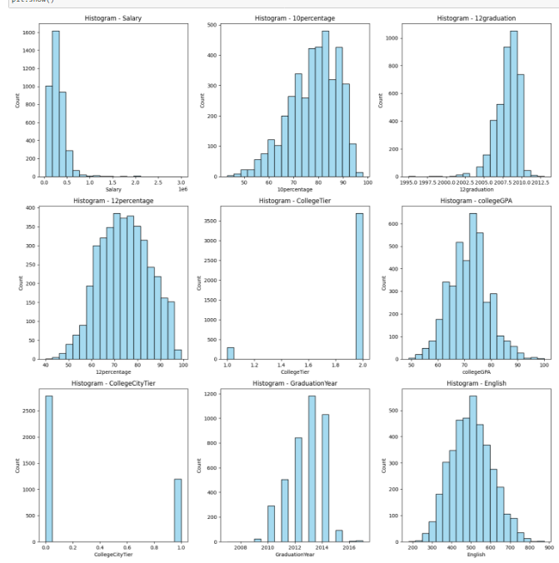

Slide 25
Plotted histplot for all numerical columns
Histogram/Histplot
A histogram is a graphical representation of the distribution of a dataset. It provides a visual summary of the underlying frequency or probability distribution of a continuous or discrete set of values. The histogram displays the data in the form of bars, where the length or height of each bar corresponds to the frequency or relative frequency of values falling within specific intervals, known as bins.
Observations:
-> In the histogram of candidates salaries, we observe a right-skewed distribution, indicating that a majority of candidates earn salaries on the lower end.
->The peak of the distribution is concentrated in the lower salary values, suggesting that most candidates fall into the lower to mid-tier salary brackets.
->The histogram of '10percentage' suggests a distribution that is slightly left-skewed. The central tendency, as indicated by both the mean and median, is positioned at between 70-80%, with the mean slightly to the left of the median. The values exhibit a gradual spread towards the right side of the distribution, indicating that a portion of individuals has '10percentage' scores that are relatively higher than the central tendency.
-> The histogram of 12Graduation seems that the majority distribution is in the year of 2010.
-> The histogram of 'CollegeGPA' reveals a distribution that is approximately symmetric. The central tendency, as indicated by both the mean and median, is positioned at in between 70-75%. The values are well-balanced on either side of the center, suggesting a relatively even distribution of 'CollegeGPA' scores.
-> The histogram of 'English, Logical and Quant are also seems as approximately symmetric.
-> The histogram of conscientiousness,agreeableness,extraversionopeness_to_experience are having left-skewed distribution.

Slide 26
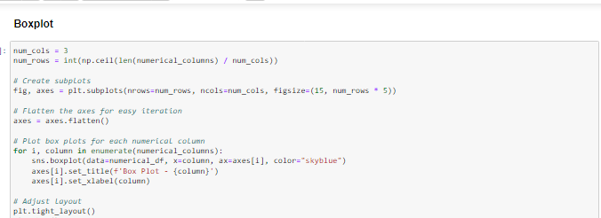
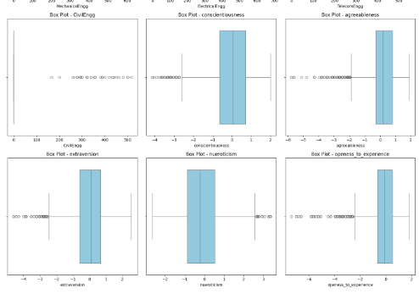
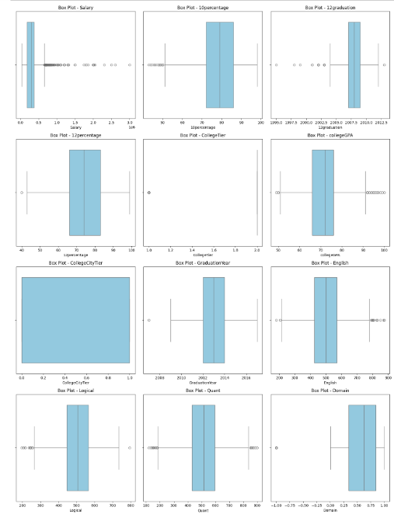

Slide 27
Univariate Analysis for categorical Columns:
countplot & Barplots
"Count" refers to the number of occurrences or instances of a particular event, item, or category within a dataset. It is a basic measure of frequency and is often used to quantify the prevalence of different values in a dataset. Counts can be applied to both categorical and numerical data, depending on the context.
A "barplot," also known as a bar chart or bar graph, is a visual representation of categorical data. It uses rectangular bars of varying lengths to show the frequency or count of each category in a dataset. Barplots are effective for comparing the distribution of different categories and identifying patterns or trends within the data.

Slide 28
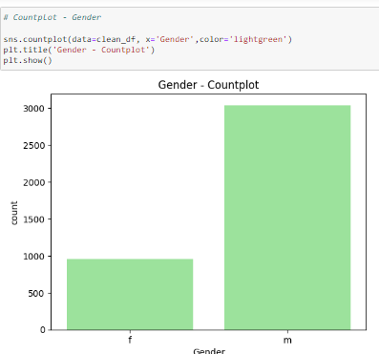
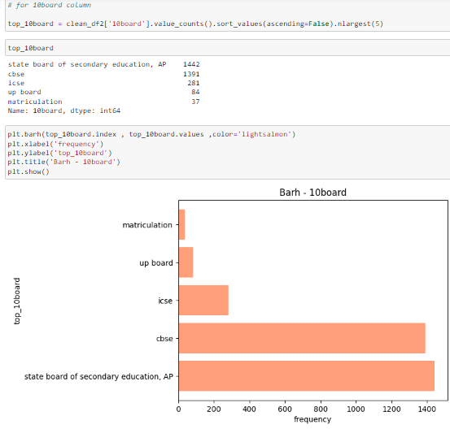
Observations:
-> The countplot representing the distribution of gender within the dataset, a predominant majority of entries are labeled as 'Men,' indicating that this dataset is predominantly composed of male individuals.
Examining the dataset, a notable observation emerges regarding the educational background of the candidates. A substantial majority of the candidates in the dataset have pursued their education under the curriculum provided by the State Board of Secondary Education, Andhra Pradesh (AP). The countplot representing the distribution of educational boards reveals that the 'State Board of Secondary Education, AP' category significantly outweighs other educational boards

Slide 29
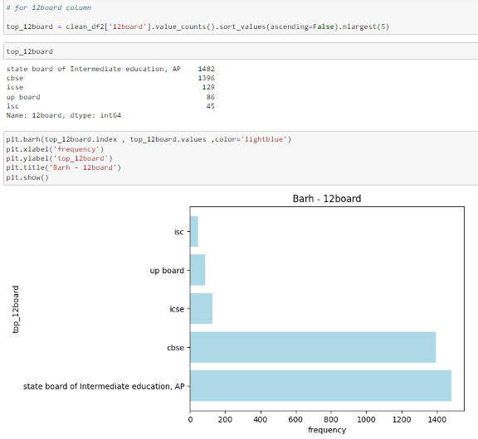
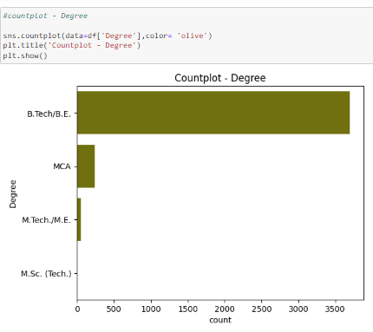
Observations:
->Building upon the previous observation regarding the educational background of the candidates, it is noteworthy that a substantial majority of individuals not only completed their secondary education under the State Board of Secondary Education, Andhra Pradesh (AP), but they also pursued their intermediate education through the State Board of Intermediate Education, AP. The countplot depicting the distribution of intermediate education boards underscores the prevalence of candidates with this educational background.
->An evident trend surfaces upon analyzing the dataset, revealing that a substantial number of individuals have pursued a Bachelor of Technology (B.Tech) degree. The countplot representing the distribution of degrees indicates a predominant concentration of candidates with B.Tech qualifications.
In [ ]:

Slide 30
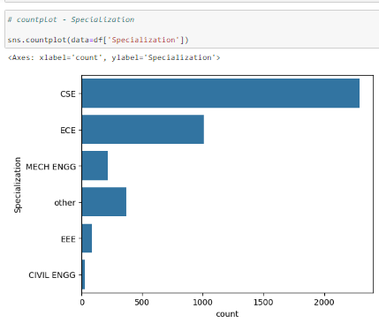
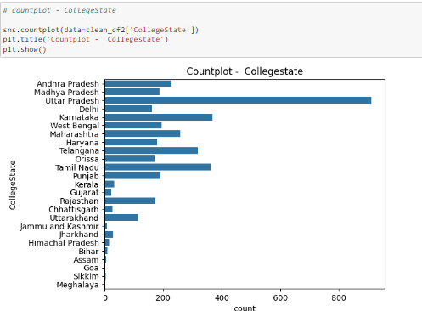
Observations:
-> "Delving into the dataset's exploration of academic specializations, a noteworthy trend emerges regarding the choices made by candidates in their respective fields of study. The countplot illustrating the distribution of specializations reveals a clear dominance of individuals specializing in CSE(computer science & Engineering). This specialization stands out as the most frequently chosen among the sampled candidates. Following closely, the second most prevalent specialization is ECE(Electrical and Computer Engineering).
->In examining the distribution of colleges across different states, a conspicuous trend emerges with Uttar Pradesh prominently featured in the countplot. The majority of individuals in the dataset hail from colleges located in Uttar Pradesh, as evidenced by the considerably higher count compared to other states.

Slide 31
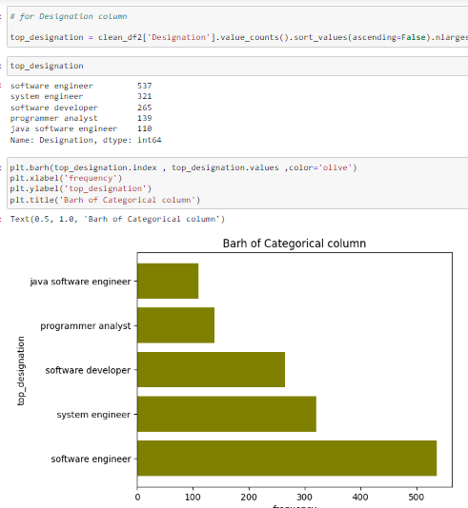
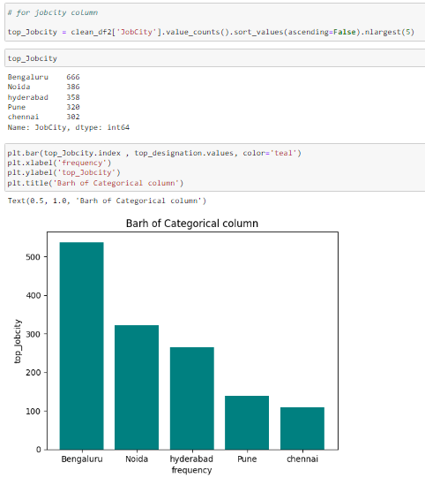
Observations:
->The horizontal bar plot detailing the count of different job designations reveals distinctive patterns in the dataset's employment landscape. Notably, 'Software Engineer' stands out as the most frequently occurring job designation, with an impressive count of 537. Following closely are 'System Engineer' and 'Software Developer' with counts of 321 and 265, respectively. 'Programmer Analyst' and 'Java Software Engineer' round out the top five designations, each contributing to the diverse array of roles within the dataset.
->The bar plot illustrating the distribution of job locations reveals a striking trend, with Bengaluru emerging as the predominant city among the sampled individuals. A significant majority of students have secured job placements in Bengaluru, as evidenced by the notably high count in the dataset.

Slide 32
Bivariate analysis:
Bivariate analysis involves the simultaneous examination of two variables to understand the relationships between them. Common techniques include scatter plots, correlation coefficients, and regression analysis. This analysis helps uncover patterns, dependencies, or correlations, providing insights into the association between two variables in a dataset.
Bivariate analysis explores how changes in one variable correlate with changes in another, revealing the strength and direction of their relationship. It aids in identifying patterns, trends, and potential causal connections, offering a deeper understanding of the interdependencies between the two variables in the context of a dataset. This analysis is crucial for informed decision-making and predictive modeling.
Additionally, bivariate analysis enables the assessment of causality through experimental designs or observational studies, shedding light on the impact of one variable on the other. It often involves statistical tests such as t-tests or chi-square tests to determine the significance of observed relationships, enhancing the interpretability and reliability of the findings.

Slide 33
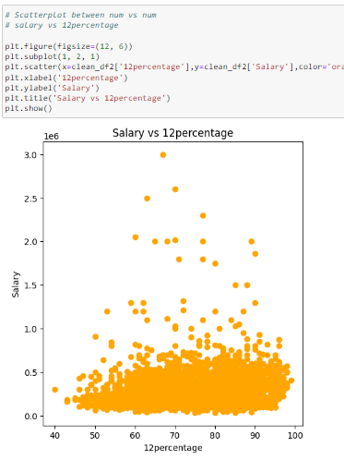
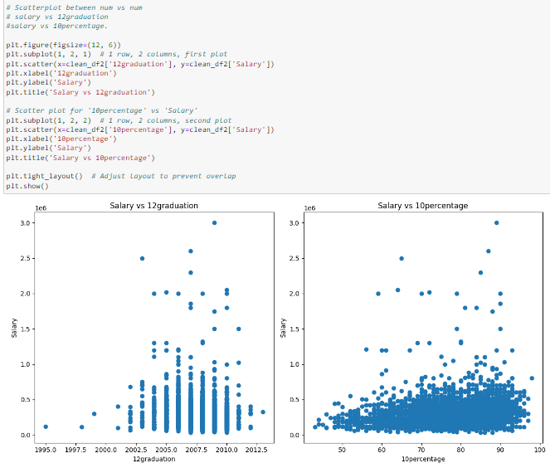
Bivariate Analysis- relationships between numerical columns:
Observations:
-> The scatter plot visualizing the relationship between the target column and the 10th-grade percentage ('10percentage') reveals interesting patterns. Higher 10th-grade percentages seem to correspond with higher values of the target variable. This positive correlation suggests that individuals with strong academic performance in their 10th-grade examinations are more likely to achieve higher values in the target variable.
->The scatter plot illustrating the relationship between the target column and the year of graduation ('12graduation') provides insights into potential temporal patterns. It appears that individuals who graduated in certain years tend to cluster around specific values of the target variable. This observation could indicate that the year of graduation might have an influence on the target variable.
>Upon closer examination of the dataset, a notable trend becomes apparent when considering the relationship between 12th-grade percentages and current salaries. Individuals who achieved scores in the range of 60-80% during their 12th-grade examinations appear to be associated with higher current salaries. The scatter plot depicting this relationship suggests a positive correlation, indicating that as 12th-grade percentages increase within this specified range, there is a corresponding increase in current salaries.

Slide 34
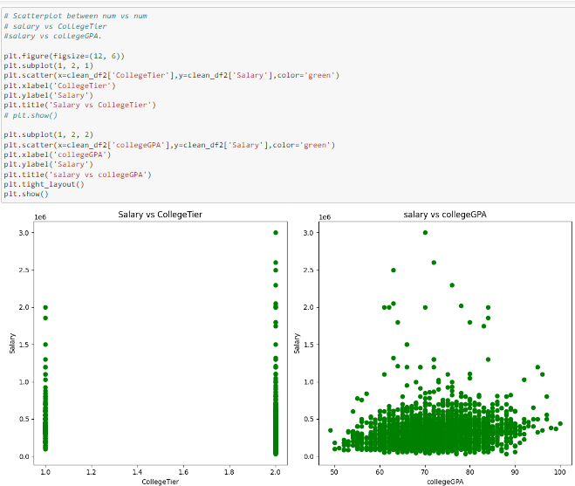
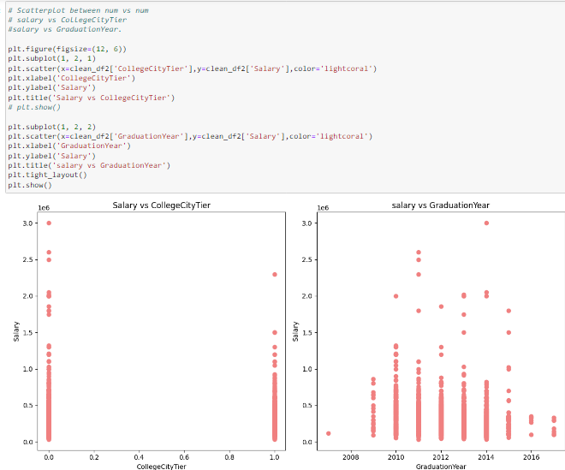
Observation:
->A clear trend emerges as we explore the dataset, revealing that individuals who graduated from Tier 2 colleges tend to have higher reported salaries.
->A clear trend in the dataset suggests that individuals with college GPAs falling within the 60-80% range tend to report higher salaries.
->A quick look at the data suggests a strong link between graduation year and salary outcomes. Those who completed their education in 2015 appear to enjoy higher salaries

Slide 35
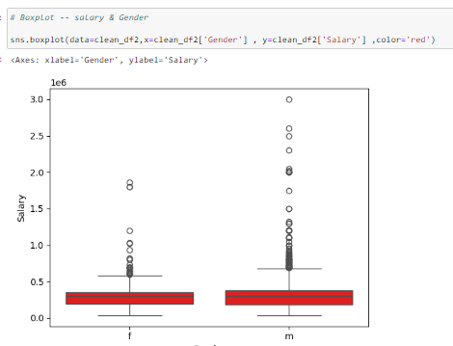
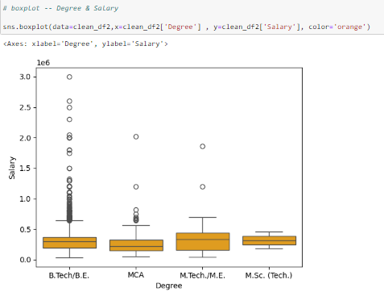
BOX PLOT BETWEEN CATEGORICAL VS NUMERICAL:
When creating boxplot for a categorical versus numerical columns ,each boxplot represents the distribution of the numerical variable for each category
->The box in the middle of the part represents the interquantile range(IQR),which is the range between the first quantile(Q1) and the third quantile Q3.The height of the box indicates the spread of the 50% of the data
-> The line within the box represents the median(Q2) which is the middle value of the dataset.It provides a measure of central tendency.
Observations:
-> The boxplot analysis reveals a distinct pattern in the distribution of salaries between male and female categories.
->The interquartile range (IQR) indicates greater variability in salaries for males, contributing to a broader spread of data. The presence of potential outliers among males implies that some individuals earn significantly higher salaries than the typical range observed for females.
-> The boxplot insights indicate distinct salary trends among B.Tech, MCA, MTech, and MSc graduates, highlighting B.Tech's superior median salary and greater variability.

Slide 36
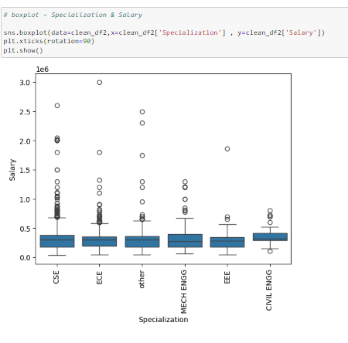
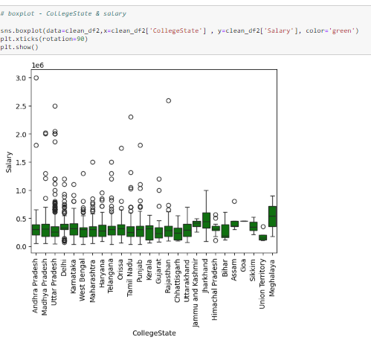
Observations:
-> The bar plot accentuating the association between different specializations and corresponding salaries offers valuable insights. Notably, candidates specializing in ComputerScience consistently emerge as top earners, showcasing a distinct salary advantage

Slide 37
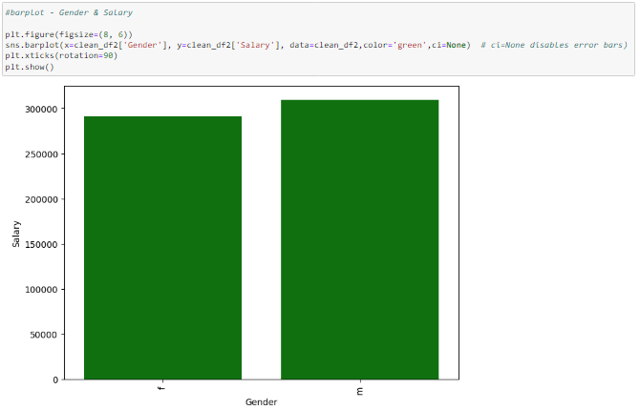
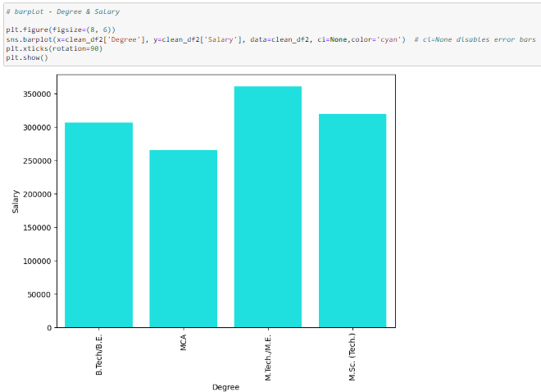
BAR PLOT BETWEEN CATEGORICAL VS NUMERICAL COLUMNS:
Observations:
-> The bar plot depicting salary differences between male and female individuals succinctly reveals a noteworthy trend. Men consistently exhibit higher average salaries, evident by the taller bar representing male earners. This visual insight emphasizes a clear gender-based salary gap within the dataset
->M.Tech graduates stand out as high earners, showcasing a clear correlation between pursuing an M.Tech degree and elevated salaries within the dataset.

Slide 38
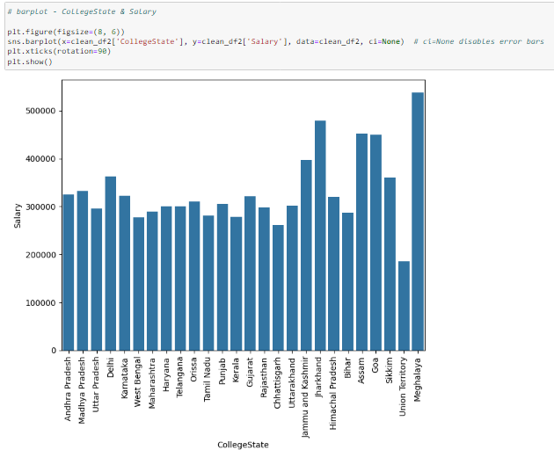

Observations:
->Most of the candidates who belongs to Mehalaya State are earning high salaries when compared to other states.
-> Candidates whose designation is Application developer,programmer, software test enginner are earning higher salaries, between three of them the highest salary package is earning by programmer candidates.

Slide 39


Identify relationships between categorical and categorical columns using stacked bar plots:
Observations:
-> Most of the candidates male and female are from B.tech background,only few candidates are from MCA background.
-> Most of the candidates are from CSE Specialization background,and also some candidates are from ECE Specialization background.

Slide 40

RESEARCH QUESTIONS:
*Times of India article dated Jan 18, 2019 states that “After doing your Computer Science Engineering if you take up jobs as a Programming Analyst, Software Engineer, Hardware Engineer and Associate Engineer you can earn up to 2.5-3 lakhs as a fresh graduate.”

Slide 41


Yes, after completing Computer Science & Engineering if we take up jobs as a Programming Analyst, Software Engineer or Associate Engineer we can earn up to 2.5-3 lakhs .
There is no hardware engineer present in the dataset.

Slide 42

Test this claim with the data given to you. Is there a relationship between gender and specialization? (i.e. Does the preference of Specialisation depend on the Gender?)
When testing the relationship between two categorical variables (cat vs cat), you can use various statistical methods and visualization techniques

Slide 43
CONCLUSION:
Concluding an Exploratory Data Analysis (EDA) project involves summarizing key findings, insights, and implications drawn from the analysis. Embarking on a comprehensive exploration of the AMEO dataset, the journey commenced with a meticulous phase of data cleaning, preprocessing, handling missing values. Recognizing the impact of outliers on statistical measures, a dedicated focus was placed on identifying and managing these extreme values. To enhance the precision of the analysis, certain columns underwent type casting. This step involved converting data types to align with their nature, ensuring accurate representation and facilitating more robust statistical computations.
Upon thorough examination of the AMEO dataset, it highlights a predominant representation from tier-2 colleges. It predominantly features males educated under the State Board of Secondary Education, Andhra Pradesh. B.Tech graduates, especially in CSE, are prevalent, and most individuals are from Uttar Pradesh. Bengaluru emerges as the primary job city, and 'Software Engineer' is the top designation. Notably, Tier 2 college graduates tend to have higher salaries, and male earners consistently earn more. The dataset unveils clear trends in job roles and specializations influencing salary outcomes of AMCAT aspirants.

Slide 44

THANK YOU😊

